Slide 2
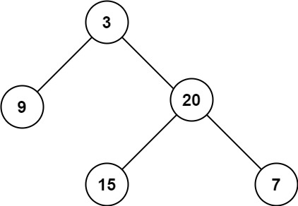
Global CountMax=0;
CountMax=1;
Stp1. Count=1
Stp3. Count=2
CountMax=2;
CountMax=2;
CountMax=2;
Stp4. Count=2
Stp2. Count=2
CountMax=3;
CountMax=3;
Stp5. Count=3
Stp6. Count=3

